Slide 1

IOT BASED IMAGE PROCESSING FOR WASTE SEGREGATION
A.ESAKKI RAJA
953223105032
EEE-III YEAR

Slide 2
Introduction:
Solid waste management is one of the major challenges in urban and rural areas. Improper segregation of waste leads to environmental pollution, health issues, and difficulty in recycling processes.
Image processing plays an important role in automating such systems by enabling machines to visually identify and classify objects.
In this project, an ESP32-CAM module is used to capture real-time images of waste materials. These images are transmitted to a computer where a Python-based YOLO (You Only Look Once) algorithm processes them.
The system is designed specifically to detect whether the object is plastic or non-plastic. This approach helps in automating waste segregation and reducing human effort.

Slide 3
PROBLEM STATEMENT:
In many places, waste segregation is still done manually, which is inefficient and error-prone. Mixing of plastic and non-plastic waste reduces recycling efficiency and increases environmental hazards.
Plastic waste, in particular, causes long-term damage to ecosystems if not properly separated and processed.
There is a need for an intelligent system that can automatically identify plastic waste in real time and assist in segregation.
Existing systems are either expensive or complex, making them unsuitable for small-scale or low-cost implementations.

Slide 4
OBJECTIVES:
The main objective of this project is to develop a smart waste segregation system that can automatically detect plastic materials using image processing techniques.
The system aims to capture images using an ESP32-CAM module and process them using the YOLO algorithm in Python.
Another objective is to build a cost-effective and efficient solution that can be used in real-world applications such as households, public places, and industries.
The project also focuses on reducing human intervention and improving the accuracy of waste classification.

Slide 5
COMPONENTS USED:
The ESP32-CAM module acts as the main hardware component, which includes a camera and built-in WiFi capability.
It is responsible for capturing images and sending them for processing. An FTDI programmer is used to upload code into the ESP32-CAM module.
A computer or laptop is required to run the Python environment and YOLO model for image processing.
A stable WiFi network is necessary for communication between the ESP32-CAM and the computer.
Power supply is provided to operate the module.
Software components include Python programming language and YOLO library for object detection

Slide 6
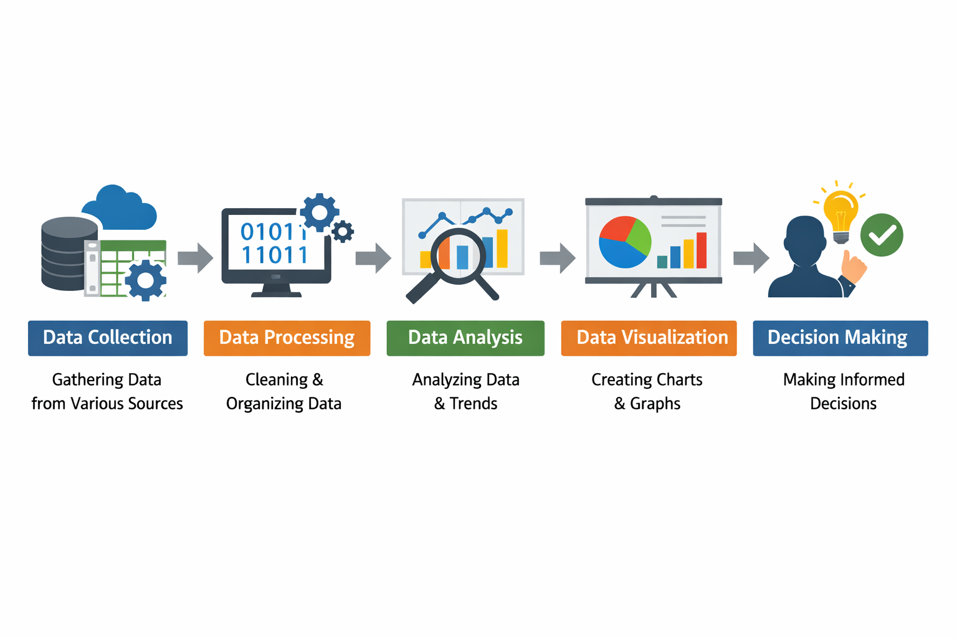
Block diagram:

Slide 7



SMART WASTE SEGREGATION system:
Smart Automation
Plastic detection
Artificial Intelligence
IOT enabled system

Slide 8
SYSTEM WORKING PRINCIPLE
Plastic Detection system
Image capture
ESP32-cam
Automation

Slide 9
Results and discussions:
Results:
The system successfully captured real-time images using the ESP32-CAM and transmitted them through WiFi for processing. The YOLO algorithm was able to identify plastic and non-plastic objects with good accuracy under proper lighting conditions. The detection process was fast and suitable for real-time applications, showing stable and continuous performance during testing.
Discussion:
The accuracy of the system mainly depends on lighting conditions, image clarity, and the quality of the trained dataset. The ESP32-CAM provides a low-cost solution, but its limitations are overcome by using Python-based YOLO processing. The system is scalable and effective for basic waste segregation, but it can be further improved to detect multiple types of waste and enable automatic physical segregation.

Slide 10
CONCLUSION:
This project demonstrates an effective and low-cost solution for smart waste segregation using image processing. By integrating the ESP32-CAM module with the YOLO algorithm, the system is able to identify plastic waste in real time with good accuracy and efficiency.
The proposed system reduces the need for manual segregation, minimizes human error, and promotes faster recycling processes. It highlights how technology can be used to solve real-world environmental problems in a practical and scalable manner.
From a societal perspective, this system can contribute to cleaner surroundings, reduced plastic pollution, and improved public health. If implemented on a larger scale in public places and urban areas, it can support sustainable waste management practices and help build a cleaner and greener future.

